Slide 1
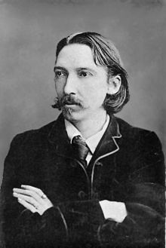
Robert Louis Stevenson

Slide 2
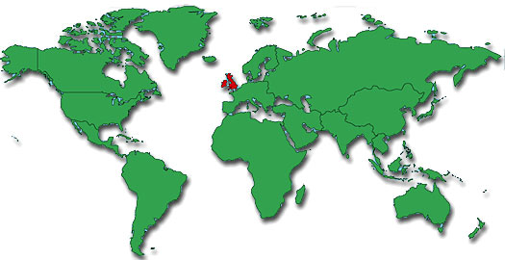
Born: November 13,1850 in Scotland.
What continent is Scotland on?

Slide 3
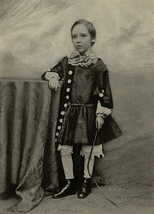
Childhood
Stevenson became sick very often in his childhood.
Very often he would have to stay in his bed for weeks at a time, so he missed a lot of school.
When he was bored he would dream about adventures and far-away lands.
He LOVED to write stories!

Slide 4
The Land Of Counterpane
By: Robert Louis Stevenson
When I was sick and lay a-bed,
I had two pillows at my head,
And all my toys beside me lay,
To keep me happy all the day.
And sometimes for an hour or so
I watched my leaden soldiers go,
With different uniforms and drills,
Among the bed-clothes, through the hills;
And sometimes sent my ships in fleets
All up and down among the sheets;
Or brought my trees and houses out,
And planted cities all about.
I was the giant great and still
That sits upon the pillow-hill,
And sees before him, dale and plain,
The pleasant land of counterpane.

Slide 5
What does it say?
What does it mean?
Why does it matter?

